Slide 1
Data Structures and Algorithms
INFO-3135
Hashing – Concepts and Algorithms

Slide 2
Ordering Elements in a Collection
We care about the order of elements in a collection for two reasons:
  Knowing how data is stored
  Being able to quickly retrieve the data
So far, we have assumed one of two things in our implementation of collections . . .
Order is determined by:
  The order in which elements are added to and/or removed from a collection, for example, stacks, queues, indexed lists
  Comparing values or keys of elements, for example, ordered lists, binary search trees

Slide 3
Introduction to Hashing

Slide 4
Ordering Elements using Hashing
Hashing is a new concept where the order of an element is determined by a hashing function based on its value or key
  Elements are stored in a hash table with their location in the table determined by a hashing function
  Each location in a hash table is referred to as a cell or a bucket
Hashing functions are used to determine an element’s position or index in a hash table
Example:
  Create an array to hold 14 names
  Create a hashing function that equates each name to a position in the array based on a formula using its ASCII values
    Given the name “Elizabeth”, would be mapped to Index 0 of the array
    Given the name “Doug”, would be mapped to Index 3 of the array
0 | Elizabeth
1
2
3 | Doug
4
5
6
7
8
9 | Ian
10
11 | Anne
12
13 | Henry

Slide 5
Hashing Function Example
We want to store a list of names where:
  Each name is passed to a hashing function which converts the name into a numerical index
  The name is stored at that index
  The name is retrieved using that index
0 | Elizabeth
1
2
3 | Doug
4
5
6
7
8
9 | Ian
10
11 | Anne
12
13 | Henry
int hashFunction(string key)
{
int hash = 0;
int counter = 1;
for (char ch : key)
hash += ch * counter++;
return hash % 14;
}
For key Henry:
hash = 72*1 + 101*2 + 110*3 + 114*4 + 121*5
hash = 1665 % 14
hash = 13
For key Luke:
hash = 76*1 + 117*2 + 107*3 + 101*4
hash = 1035 % 14
hash = 13
Luke

Slide 6
A Weak Hashing Example
A sample hash algorithm
Example
All the letters of a string can be added together, and the sum can be used as an index.
In this case, the map needs 3,782 elements(for a string K made out of 31 characters like “z,” h(K) = 31 * 122 = 3,782).
But even with this size, the function h does not return unique values. For example, h(“abc”) == h(“acb”), and therefore map to the same index.
The problem of non-unique keys is called collision
122 is the ascii value of lowercase ‘z’

Slide 7
Hashing
Hashing is a process used to transform data called a key into a fixed-size value
  Data can be a string or numeric
  The process is a mathematical function or algorithm called a hash function
The fixed-size value is returned by a hash function is:
  Called hash value, hash code, digest, or simply hash
  Used to index a fixed-size table called a hash table
Use of a hash function to index a hash table is called hashing or scatter storage addressing.

Slide 8
Hash Function Properties
The situation where two elements or keys map to the same location in a hash table is called a collision
A hashing function that maps each element to a unique position is said to be a perfect function
A good hash function:
  Is deterministic, that is, the same input will always produce the same hash value
  Is fast to compute
  Should distribute hash values uniformly to minimize collisions
  Should be difficult to derive the original input

Slide 9
Uses for Hashing
Hash Tables
  Used to store and retrieve data efficiently
  When used for fingerprinting, identifying files
Data integrity and checksums
  For authentication when downloading a file its hash value can be compared with a known hash to ensure the file has not been corrupted, accidentally or intentionally
  Used for digital signatures, message authentication codes (MACs), and other forms of authentication
Cryptography
  When used to ensure data security and are resistant to reverse engineering
  Used in password storage, digital signatures, blockchain technology
Data Duplication
  When used to compare whether two pieces of data are identical using their has values, rather than comparing the original data
Password Storage
  When storing passwords, systems typically hash the password before storage, so attackers do not have access to the original password

Slide 10
Perfect Hashing
A perfect hashing function occurs when:
  Each element maps to a unique position
  The data set is of known size
This efficiency is no longer realized in the case of:
  Collision
    A collision occurs when we attempt to store both “Henry” and “Luke”, and both elements map to the same location in the hash table

Slide 11
Coding Example

Slide 12
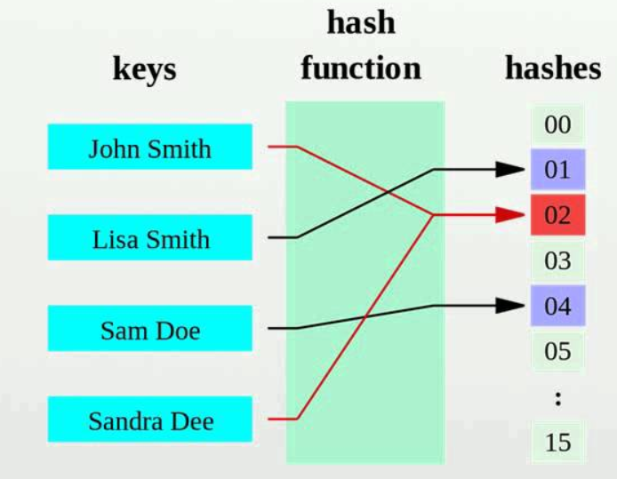
Hash Functions
We view the evaluation of a hash function, h(k), as consisting of two actions:
  Mapping the key k to an integer, called the hash code,
  Mapping the hash code to an integer within the range of indices ([0,N −1]) of a bucket array, this is called the compression function.

Slide 13
Developing a Hashing Function
We need a function h that can transform a particular key k, be it a string, number, record, or the like, into an index in a table used for storing items of the same type as k
The function h is called a hash function
A perfect hash function results if:
  h transforms different keys into different numbers
  The hash table has a size >= the number of keys
  The generated index not > size
Consideration, the number of elements is not always known ahead of time

Slide 14
Hashing Functions
The goal is to develop a function that does a reasonable job of distributing elements in a hash table such that collisions are avoided
A hash function:
  Is a calculation used to determine a unique index to a bucket in a hash table
  Must guarantee that the number it returns is a valid index to one of the table cells
Examples of Hashing Functions:
  Extraction method
  Division method
  Folding method
  Mid-square method
  Radix Transformation method
  Digit analysis method
  Length-dependent method

Slide 15
Extraction
In this method, only a part of the key is used to compute the address.
For the social security number 123-45-6789, this method might use the first four digits, 1,234; the last four, 6,789; the first two combined with the last two, 1,289; or some other combination.
Each time, only a portion of the key is used. If this portion is carefully chosen, it can be sufficient for hashing, provided the omitted portion distinguishes the keys only in an insignificant way.
For example, the starting digits of the ISBN code are the same for all books published by the same publisher (e.g., 1133 for the publishing company Cengage Learning). Therefore, they should be excluded from the computation of addresses if a data table contains only books from one publisher.

Slide 16
Division
The division method uses the remainder of the key divided by the table size as the index for the given element
The simplest way to accomplish this is to use division modulo
TSize = sizeof(table), as in h(K) = K mod TSize, if K is a number.
It is best if TSize is a prime number because prime numbers:
  help achieve a more uniform distribution of hash values
  Reduce the likely of different keys hashing to the same index (collisions)
Example:
  Hash Code (49) = k (12345) mod TSize (53)
However, nonprime divisors may work equally well as prime divisors provided they do not have prime factors less than 20 (Lum et al. 1971).
The division method is usually the preferred choice for the hash function if very little is known about the keys.

Slide 17
Folding
In this method, the key is divided into several parts
These parts are combined or folded together and are often transformed in a certain way to create the target address.
The key is divided into several parts and these parts are then processed using a simple operation such as addition to combine them in a certain way.
There are two types of folding:
  shift folding and boundary folding
In shift folding, they are put underneath one another and then processed. For example, a social security number (SSN) 123-45-6789 can be divided into three parts, 123, 456, 789, and then these parts can be added. The resulting number, 1,368, can be compressed using modulus division
With boundary folding, the key is seen as being written on a piece of paper that is folded on the borders between different parts of the key. In this way, every other part will be put in the reverse order.

Slide 18
Folding
Boundary Folding
Consider the same three parts of the SSN: 123, 456, and 789. The first part, 123, is taken in the same order, then the piece of paper with the second part is folded underneath it so that 123 is aligned with 654, which is the second part, 456, in reverse order. When the folding continues, 789 is aligned with the two previous parts. The result is 123 + 654 + 789 = 1,566. In both versions, the key is usually divided into even parts of some fixed size plus some remainder and then added.
This process is simple and fast, especially when bit patterns are used instead of numerical values.

Slide 19
Mid-Square function
In this method, the key is squared, and the middle or mid-part of the result is used as the address.
If the key is a string, it must be preprocessed to produce a number by using, for instance, folding.
The entire key participates in generating the address so that there is a better chance that different addresses are generated for different keys.
For example, if the key is 3,121, then 3,121² = 9,740,641, and for the 1,000-cell table, h(3,121) = 406, which is the middle part of 3,121².

Slide 20
Radix Transformation
Radix transformation is when the key k is transformed into another number base, using a different radix
For example, transform k from base 10 to base 9:
  Given that k1 = 345 base 10 (decimal)
  Transformed k1 = 423 base 9 (nonary)
For example, transform h from base 10 to base 9:
  Given that k2 = 245 base 10 (decimal)
  Transformed k2 = 323 base 9 (nonary)
Next apply the division method to find address, assuming table size = 100:
  k1 transformed 423 (nonary) % 10 = 23 address
  k2 transformed 323 (nonary) % 10 = 23 address
Collisions cannot be avoided

Slide 21
Avoiding Collisions
The worth of a hash function depends on how well it avoids collisions.
Avoiding collisions can be achieved by making the function more sophisticated, but this sophistication should not go too far because the computational cost in determining h(K) can be prohibitive, and less sophisticated methods may be faster.
For example, for 50 elements and a 100-cell array, there are 100⁵⁰ = 10¹⁰⁰ hash functions, out of which “only” 10⁹⁴ (one in a million) are perfect.
Most of these functions are too unwieldy for practical applications.
The number of possibilities is vast

Slide 22
Collision Resolution
Note that for almost all hash functions, more than one key can be assigned to the same position.
For example, if the hash function h1 applied to names returns the ASCII value of the first letter of each name (i.e., h1(name) = name[0]), then all names starting with the same letter are hashed to the same position.
This problem can be solved by finding a function that distributes names more uniformly in the table. For example, the function h2 could add the first two letters (i.e., h2(name) = name[0] + name[1]), which is better than h1.
But even if all the letters are considered(i.e., h3(name) = name[0] + · · · + name[strlen(name) – 1]), the possibility of hashing different names to the same location still exists.

Slide 23
Collision Resolution
The function h3 is the best of the three because it distributes the names most uniformly for the three defined functions, but it also assumes that the size of the table has been increased.
If the table has only 26 positions, which is the number of different values returned by h1, there is no improvement using h3 instead of h1.
One more factor can contribute to avoiding conflicts between hashed keys, the size of the table/array. Increasing this size may lead to better hashing
These two factors—hash function and table size—may minimize the number of collisions, but they cannot completely eliminate them. The problem of collision has to be dealt with in a way that always guarantees a solution.

Slide 24
Open Addressing Collision Resolution
When a key collides with another key, the collision is resolved by finding an available table entry other than the position (address) to which the colliding key is originally hashed.
If position h(K) is occupied, then the positions in the probing sequence are tried until either an available cell is found or the same positions are tried repeatedly or the table is full.
The simplest method is linear probing
In linear probing, the position in which a key can be stored is found by sequentially searching all positions starting from the position calculated by the hash function until an empty cell is found.

Slide 25
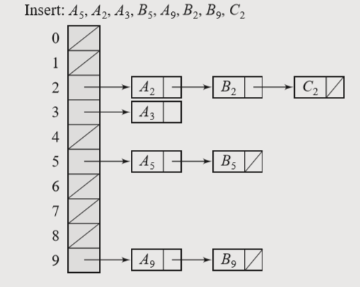
Chaining
Chaining Keys do not have to be stored in the table itself.
In chaining, each position of the table is associated with a linked list or chain of structures whose info fields store keys or references to keys.
This method is called separate chaining, and a table of references (pointers) is called a scatter table.
In this method, the table can never overflow, because the linked lists are extended only upon the arrival of new keys.

Slide 26
Bucket Addressing
Another solution is to store colliding elements in the same position in the table. This can be achieved by associating a bucket with each address.
A bucket is a block of space large enough to store multiple items. By using buckets, the problem of collisions is not totally avoided.
If a bucket is already full, then an item hashed to it has to be stored somewhere else.
By incorporating the open addressing approach, the colliding item can be stored in the next bucket if it has an available slot when using linear probing
The colliding items can also be stored in an overflow area. Each bucket includes a field that indicates whether the search should be continued in the overflow area or not. It can be simply a yes/no flag.

Slide 27
Maps
A map allows us to store elements so they can be located quickly using keys
The map stores typically stores additional useful information besides its search key, but the only way to get at that information is to use the search key.
A map stores key-value pairs (k,v), called entries, where k is the key and v is its corresponding value.
In addition, the map requires that each key be unique, so the association of keys to values defines a mapping.
To achieve the highest level of generality, both the keys and the values stored in a map can be any object type.

Slide 28
Maps
In a map example where we are storing student records (such as the student’s name, address, and course grades), the key might be the student’s ID number.
In some applications, the key and the value may be the same. For example, if we had a map storing prime numbers, we could use each number itself as both a key and its value.
We use a key as a unique identifier that is assigned by an application or user to an associated value object.
A map is used in situations where each key is to be viewed as a kind of unique index address for its value, an object that serves as a kind of location for that value

Slide 29
Hashing – Finding a key in a map
Finding a key in a map is easy if the keys are values that can be sorted
A search for a specific key uses a comparison of keys.
But not all types of keys can be easily sorted making the location of a key and it value element more difficult and less efficient
A different approach to searching calculates the position of the key in the map based on the value of the key.
The value of the key is the only indication of the position.
When the key is known, the position in the map can be accessed directly

Slide 30
Dictionaries
Like a map, a dictionary stores key-value pairs (k,v), which we call entries, where k is the key and v is the value.
A dictionary allows for keys and values to be of any object type. But, whereas a map insists that entries have unique keys, a dictionary allows for multiple entries to have the same key, much like an English dictionary, which allows for multiple deﬁnitions for the same word.
The ability to store multiple entries with the same key has several applications.
For example, we might want to store records for computer science authors indexed by their ﬁrst and last names.
Since there are a few cases of different authors with the same ﬁrst and last name, there will naturally be some instances where we have to deal with different entries having equal keys.
A multi-user computer game involving players visiting various rooms in a large structure might need a mapping from rooms to players. It is natural in this application to allow users to be in the same room simultaneously, however, to engage in battles. This game would be another application where it would be useful to allow for multiple entries with equal keys.

Slide 31
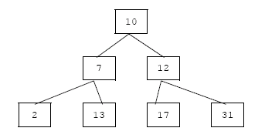
Sets
A set is a collection of distinct objects.
There are no duplicate elements in a set, and there is no explicit notion of keys or even an order.
Sets are automatically sorted.
If a set has duplicate elements, it is called a multi-set
Set are usually implemented as trees

Slide 32
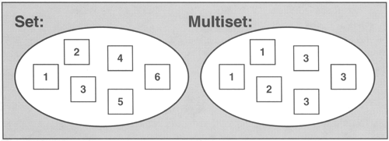
Set Operations
insert(e): Insert the element e into S and return an iterator referring to its location; if the element already exists the operation is ignored.
ﬁnd(e): If S contains e, return an iterator p referring to this entry, else return end.
erase(e): Remove the element e from S.
begin(): Return an iterator to the beginning of S.
end(): Return an iterator to an imaginary position just beyond the end of S.

